Slide 1
Introduction to Material UI
A popular UI library for React.

Slide 2
What is Material UI?
Material UI (MUI) is a popular React component library that implements Google’s Material Design principles.
It offers a comprehensive collection of pre-designed and customizable UI components to help developers build modern, responsive, and aesthetically pleasing web applications.

Slide 3

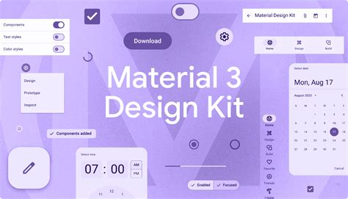
Key Features of Material UI
1
Pre-built Components
2
Material Design
Adheres to Google's Material Design principles.
Ready-to-use components for common UI elements.
3
Customization
4
Accessibility
Allows for easy customization of components.
Built with accessibility in mind.

Slide 4
Material UI Components
Buttons
Text Fields
Various button styles and functionalities.
Input fields for user input.
Cards
Grid
Containers for displaying content.
Layout system for arranging elements.

Slide 5
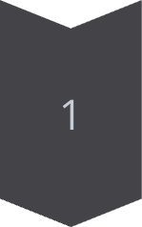
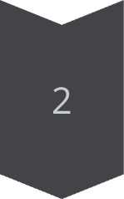
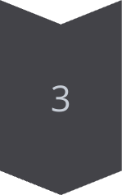
Integrating Material UI with React
Installation
Run the following command to install Material UI using npm :
npm install @mui/material @emotion/react @emotion/styled
Import Components
Import the desired components into your React components. For example, to use a button:
import Button from '@mui/material/Button';
Usage
Use the imported Material UI components in your React application.

Slide 6

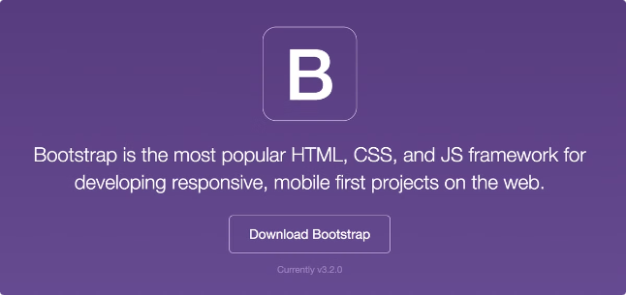
Material UI vs Other UI Libraries
Feature
Material UI
Bootstrap
Design System
Material Design
Flat Design
Components
Rich set of components
Basic components
Customization
Highly customizable
Less customizable

Slide 7



Best Practices for Material UI
Optimize Performance
Prioritize Accessibility
Maintain Design Consistency
Ensure a smooth user experience by loading components and resources only when needed, improving initial page load times.
Make your application accessible to all users, creating an inclusive and welcoming experience.
Create a cohesive and visually appealing application by using a consistent theme for colors, typography, and spacing across all Material UI components.

Slide 8
THANK YOU!

